Slide 1

Chapter 10
Modern Sequence Analysis Techniques and Tools
Teh Ying Wah tehyw@um.edu.my University of Malaya

Slide 2
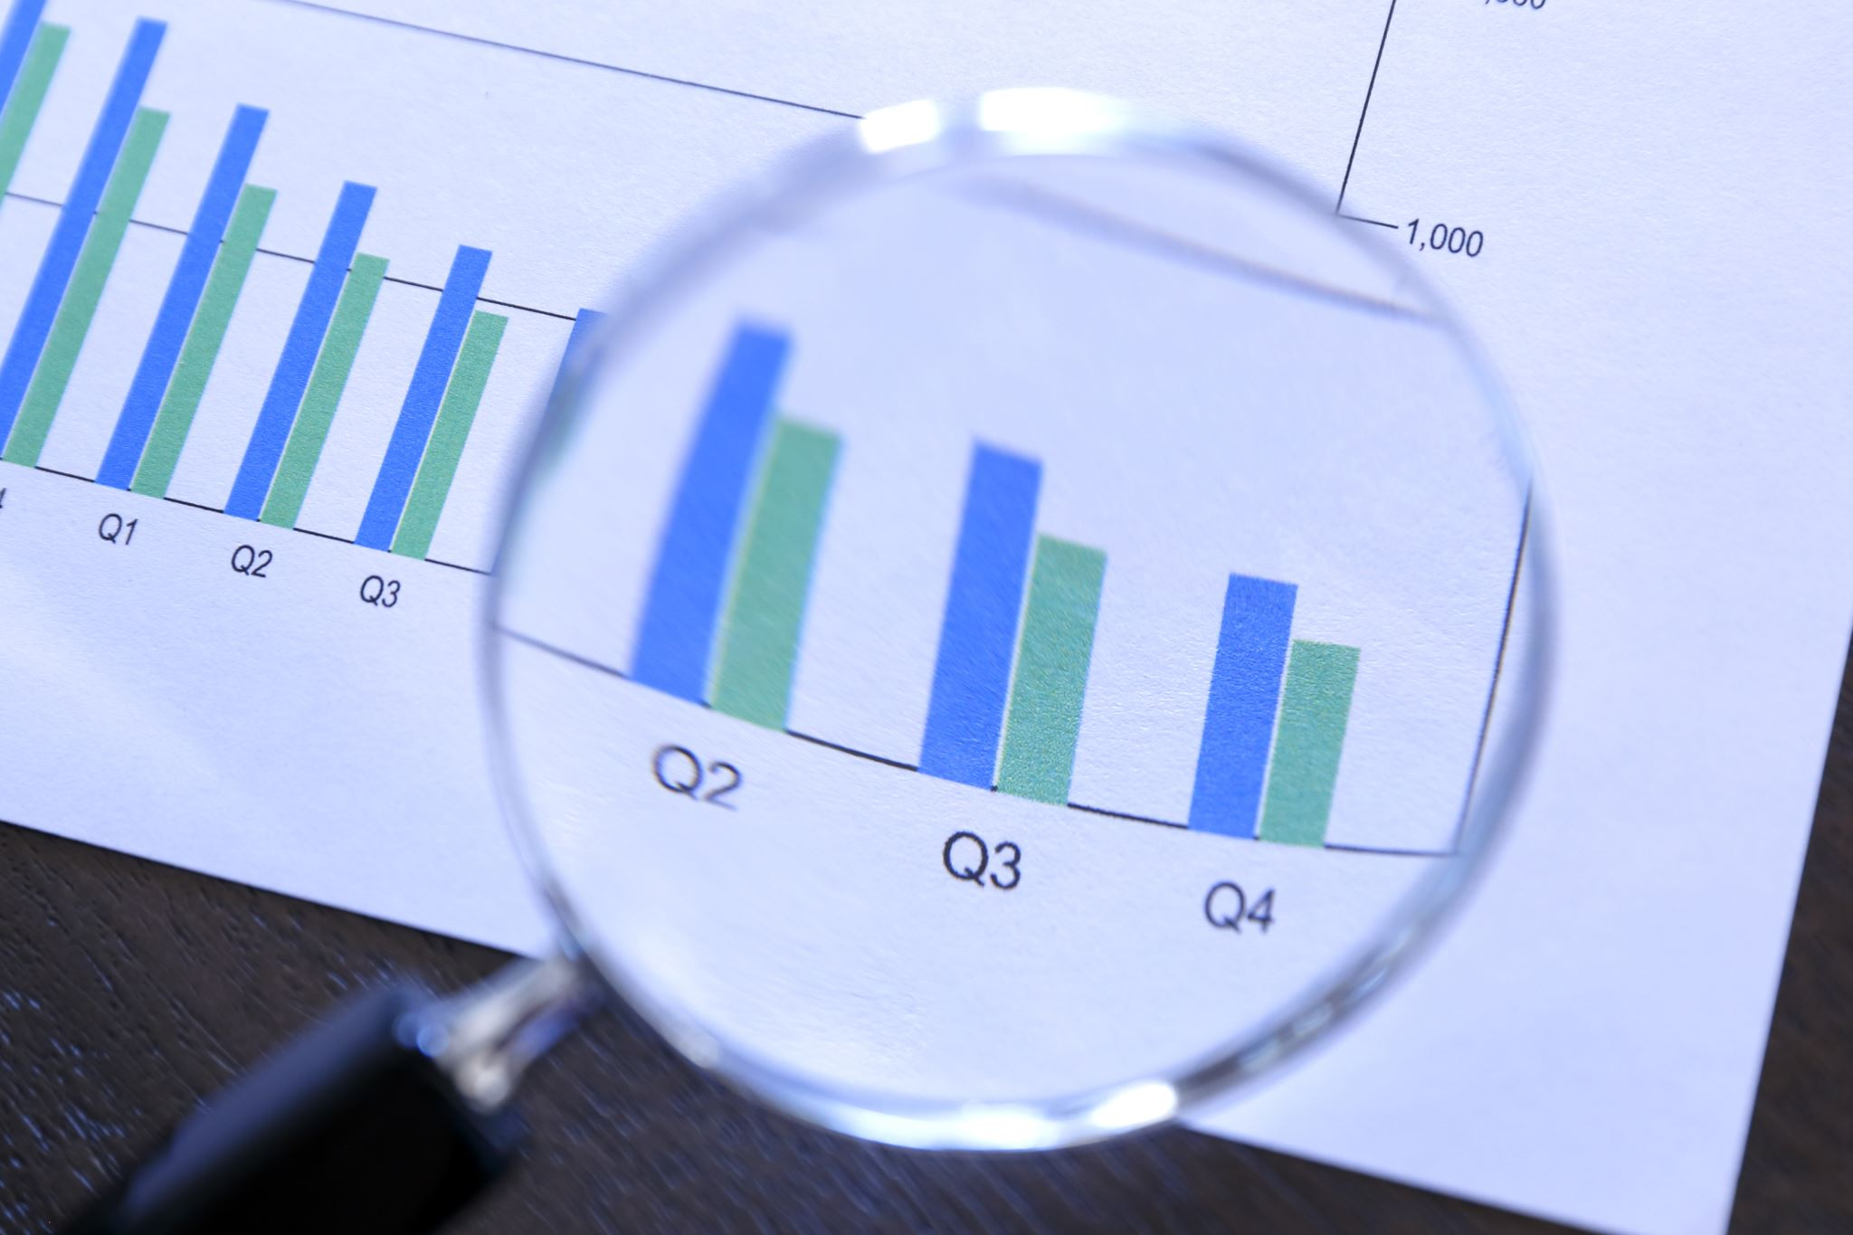
Course outline
What is Sequence analysis
Importance of Sequence Analysis
Applications of Sequence Analysis
Evolution of sequence analysis in the business context
Different types of sequence data
Uncovering Customer Service Patterns: Analysing the Order of Banking Service Usage Across Accounts
Identifying Dominant Banking Service Usage Patterns: Insights from Service Sequence Analysis
Setting Up Sequence Analysis in SAS Enterprise Miner
Evolution of sequence analysis with machine learning and deep learning.
Real-time sequence analysis in the age of big data.

Slide 3
What is Sequence analysis
Sequence analysis refers to a set of techniques used to study patterns or sequences in data. The term "sequence" can refer to many types of ordered data.
Depending on the context, sequence analysis can be applied to a variety of domains, including:
Economics and Marketing: In these fields, sequence analysis can be applied to customer purchase sequences, studying the order in which consumers buy products or services over time.
Web Analysis: Sequence analysis can be used to study patterns of web page visits. For example, a website owner might be interested in the typical sequences of page views leading up to a purchase on an e-commerce site.
Text Analysis: In the realm of natural language processing, sequence analysis can be applied to study patterns in text, such as the order of words or sentences.
Time Series Analysis: Though slightly different, time series analysis deals with ordered data points (usually over time) and can be thought of as a type of sequence analysis.

Slide 4
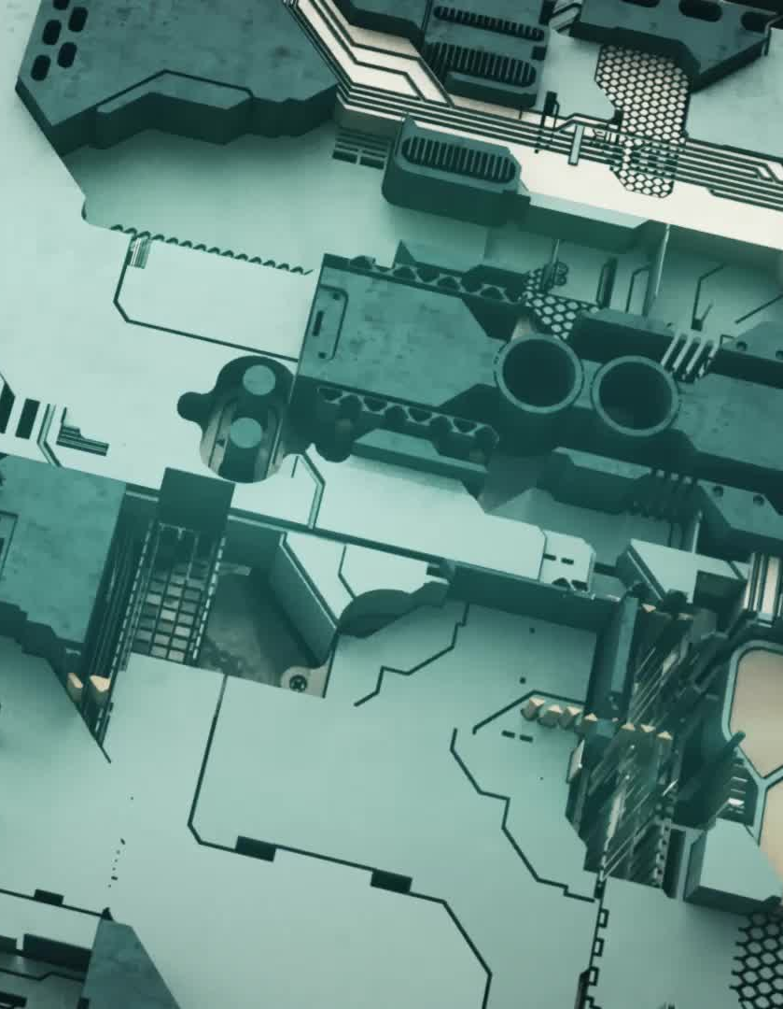
Transformer models for NLP as a powerful new tool in sequence analysis.
Transformer models have indeed become a powerful tool for sequence analysis, particularly in Natural Language Processing (NLP).
Transformers in NLP: Transformer models, such as BERT (Bidirectional Encoder Representations from Transformers) and GPT (Generative Pre-trained Transformer), are advanced neural networks that have revolutionized sequence analysis in text. They analyse sequences by understanding the contextual relationships between words in a text, which is particularly useful for tasks such as translation, sentiment analysis, and summarization.

Slide 5

Importance of Sequence Analysis
Predictive Capabilities: Once patterns are recognized, they can be used to predict future events or sequences, which is valuable in many fields, from finance to medicine.
use of RNNs, LSTMs, and Transformers for predictions in sequence data.
Recurrent Neural Networks (RNNs)
How They Work: RNNs are designed to handle sequence data by using a recurrent loop, allowing information from previous time steps to be passed along. This makes them useful for data where the order of events matters, such as time-series forecasting.
Strengths: Suitable for relatively short sequences where the model needs to remember past information (e.g., predicting the next word in a sentence).

Slide 6
Long Short-Term Memory Networks (LSTMs)
How They Work: LSTMs are a type of RNN that use gates (input, forget, and output gates) to control the flow of information. This allows them to better capture long-term dependencies, making them more effective for sequences where older information is important.
Strengths: Good at capturing both short-term and long-term dependencies, making them ideal for longer sequences than those handled by basic RNNs.
Can remember important context over extended periods due to their special architecture.

Slide 7
Transformers
How They Work: Transformers use a self-attention mechanism that allows them to focus on all parts of a sequence simultaneously, rather than processing step-by-step like RNNs or LSTMs. This means they can understand relationships between distant elements more efficiently.
Strengths: Parallel Processing: Unlike RNNs and LSTMs, Transformers can process entire sequences in parallel, drastically reducing training time.
Handling Long Sequences: Capable of maintaining context over very long sequences without suffering from vanishing gradients, which makes them ideal for complex and lengthy data.

Slide 8

Importance of Sequence Analysis
Personalization: In business contexts, understanding sequences of user behaviors can lead to personalized recommendations or targeted marketing strategies.
Efficiency: Detecting patterns or common sequences can help optimize processes or systems. For instance, understanding common web navigation paths can inform website design to improve user experience.

Slide 9
Applications of Sequence Analysis
Economics and Marketing:
Customer Journey Analysis: Understanding the sequence of touchpoints a customer interacts with before making a purchase.
Market Basket Analysis: Studying the sequence of items bought together in retail.
Web and User Experience:
Web Navigation Analysis: Understanding the sequence of web pages visited by users.
User Behaviour Sequencing: Analysing the order in which users interact with features in software or apps.
Finance:
Trading Strategies: Developing strategies based on the sequence of past market events.
Fraud Detection: Detecting unusual sequences of transactions that might indicate fraudulent activity.

Slide 10
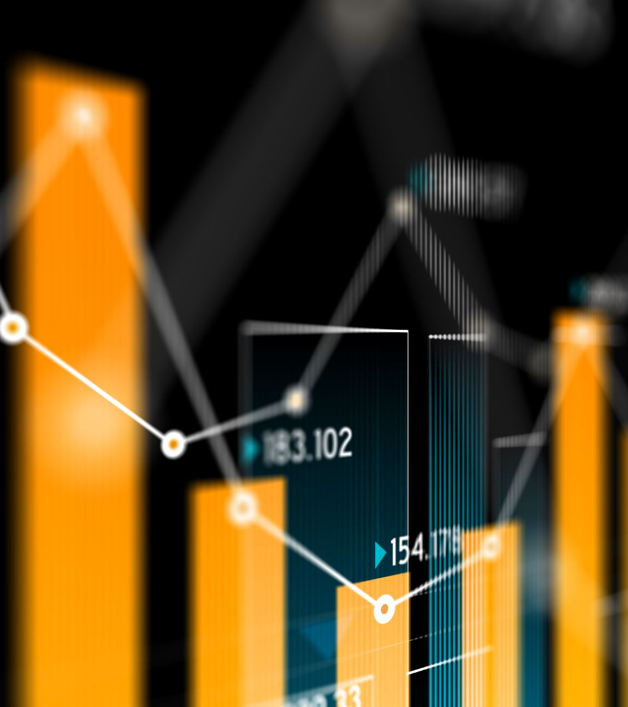
Modern Applications of Sequence Analysis
NLP: Predictive text generation using GPT models.
Finance: Real-time fraud detection using streaming analytics.
Healthcare: Patient treatment path analysis for personalized care.

Slide 11
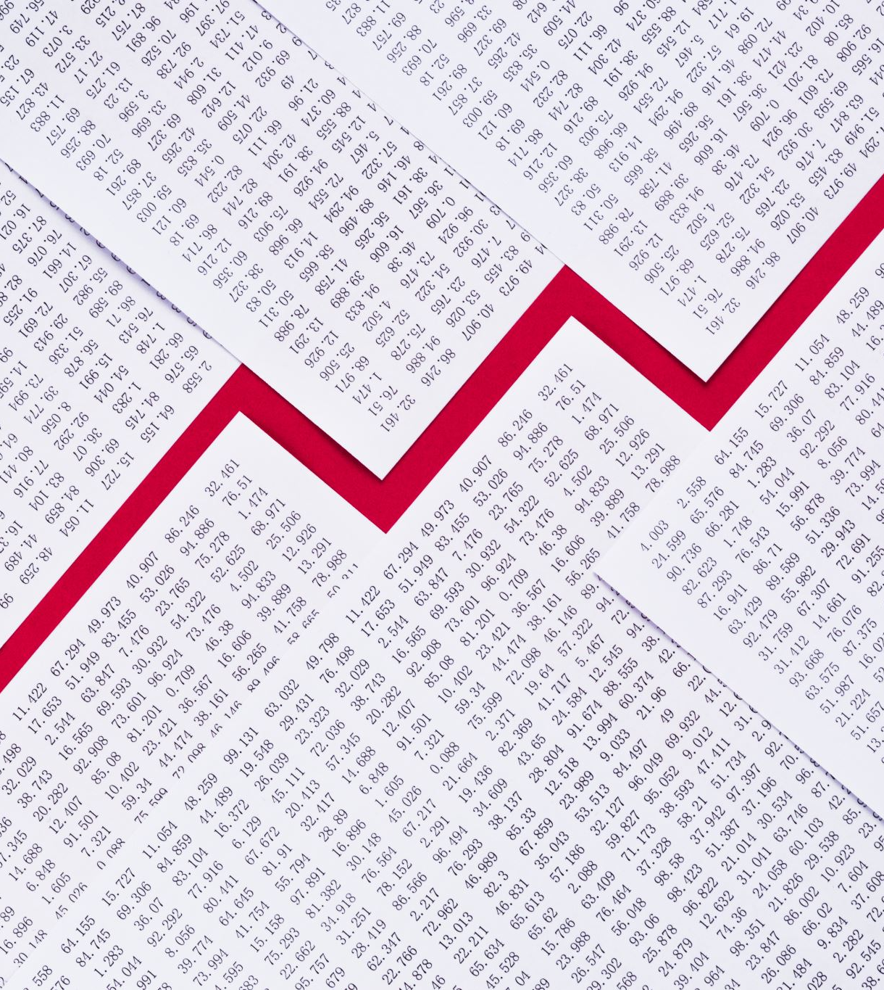
Evolution of sequence analysis in the business context
1. Early Applications in Market Research:
1970s-1980s: The concept of analysing customer purchase sequences began to emerge. Retailers and marketers started recognizing the value of understanding customer behaviour through the sequences of their purchases.
2. Advent of Customer Relationship Management (CRM):
1990s: With the rise of CRM systems, businesses began collecting more structured data on customer interactions. This allowed for more systematic sequence analysis of customer touchpoints, from initial contact to sales.
3. E-commerce and Web Analytics:
Late 1990s-2000s: The boom in e-commerce led to the proliferation of digital data. Web analytics tools allowed businesses to track the sequence of web pages visited by users, providing insights into online browsing and purchasing behaviours.

Slide 12
Evolution of sequence analysis in the business context
4. Advanced Analytics & Data Mining:
2000s: As data mining techniques became more mainstream in the business world, sequence analysis tools were incorporated into software platforms like SAS, SPSS, and later, open-source platforms like R and Python.
5. Customer Journey Mapping:
2010s: With the customer experience becoming a central focus for businesses, the concept of customer journey mapping became popular. This involves analysing the sequence of touchpoints a customer interacts with across multiple channels, helping businesses optimize the customer experience.
6. Big Data and Real-Time Analytics:
2010s-Present: The big data revolution provided businesses with vast amounts of sequential data in real-time. This led to the development of real-time sequence analysis techniques, especially in sectors like finance (for fraud detection) and e-commerce (for real-time product recommendations).

Slide 13
Evolution of sequence analysis in the business context
7. Integration with Machine Learning:
Late 2010s-Present: With the rise of machine learning in the business domain, sequence analysis techniques have been integrated with predictive models. For instance, analyzing sequences of user behaviors to predict churn or using sequence data for targeted advertising.
8. Applications in Supply Chain and Operations:
In the context of supply chain and operations, sequence analysis has been applied to optimize production processes, inventory management, and logistics, analyzing sequences of operations to improve efficiency.
9. Personalization and Recommender Systems:
2010s-Present: E-commerce platforms and content providers (like Netflix or Spotify) use sequence analysis to understand user behaviors over time, which feeds into personalized recommendations.
10. Internet of Things (IoT):
2010s-Present: With the proliferation of IoT devices in sectors like retail, healthcare, and manufacturing, sequence analysis of time-stamped data from these devices offers insights into user behaviors, equipment maintenance schedules, and more.
2020s-Present: Big Data and AI Integration: Use of cloud services like AWS for scalable sequence analysis. Real-Time Analytics: Growth of technologies like Apache Kafka for streaming data analysis.
In summary, sequence analysis in the business domain has evolved from simple analyses of purchase sequences to sophisticated, real-time analytics that encompass a wide range of business activities. As technology and data collection methods continue to advance, the applications of sequence analysis in business are likely to expand even further.

Slide 14
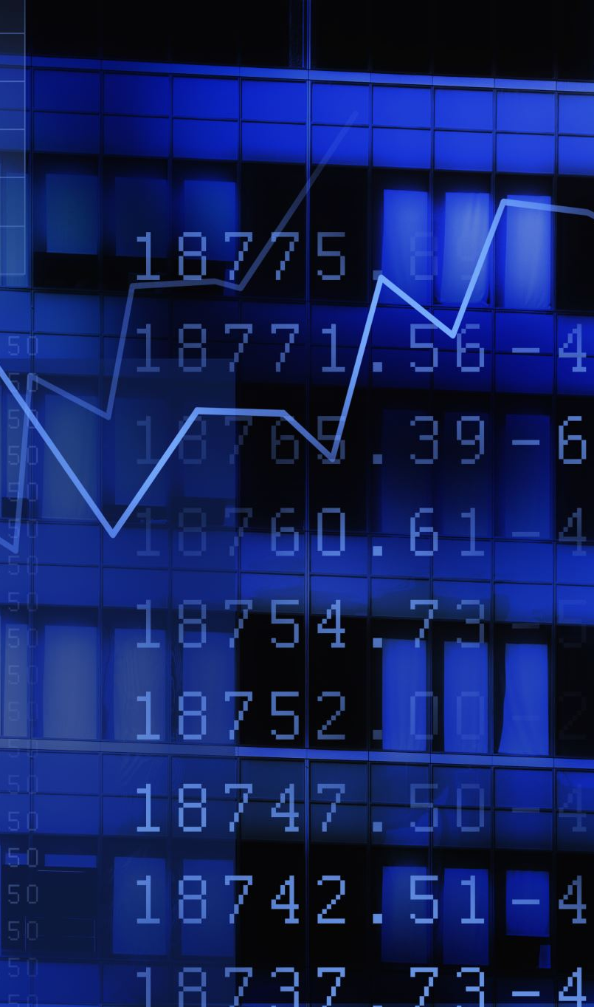
Different types of sequence data
Sequence data refers to any data that involves an ordered list of elements, where that order is essential to the meaning or analysis of the data.
1. Time Series Data:
Financial Data: Sequences of stock prices, interest rates, or economic indicators over time.
Sensor Data: Readings from sensors over time, such as temperature or acceleration data.
Medical Data: Sequences of a patient's vital signs, lab results, or treatment dates.
2. Event Sequences:
Transaction Data: Sequences of purchases or financial transactions by an individual or organization.
Web Browsing Data: Sequences of webpages visited by a user.
Log Data: Sequences of events logged by software systems or applications.
3. Behavioral Sequences:
Customer Journey Data: Sequences of interactions a customer has with a brand or product.
User Interaction Data: Sequences of user actions within an application, like clicks, scrolls, and navigation.
4. Streaming Sensor Data:
For smart cities and IoT.
Each type of sequence data may require different analysis techniques, tailored to the specific characteristics and patterns within the data. In many cases, the goal is to find common sequences, predict future elements in the sequence, or categorize sequences into different groups based on similarity.

Slide 16
Uncovering Customer Service Patterns: Analyzing the Order of Banking Service Usage Across Accounts
In the association rule mining , we primarily focused on the frequency of individual service usage, not the sequence in which different services were used in conjunction with each other. Let's analyse the sequences of services used across different accounts.
This time, we will consider the order of services and identify the most common sequences in which multiple services are used by customers.

Slide 17
Identifying Dominant Banking Service Usage Patterns: Insights from Service Sequence Analysis
This time, with a focus on the actual sequences of services used, we see a different pattern in the data:
Most Common Service Sequences
SVG -> CKING: Occurred 2 times.
CKING -> SVG: Occurred 2 times.
ATM -> CKING -> SVG: Occurred 2 times.
CKING -> ATM: Occurred 1 time.
ATM -> SVG -> CKING: Occurred 1 time.

Slide 18
Exploring Customer Service Usage Patterns: A Sequence Analysis of Banking Service Combinations
These results show the most common sequences in which multiple banking services are used in conjunction with each other. For instance, the sequences "SVG -> CKING" and "CKING -> SVG" both occurred twice, indicating a common pattern of customers using savings and checking services in these particular orders.
This sequence analysis is more informative than the previous frequency analysis, as it reveals the typical customer journeys through different banking services. This information can be highly valuable for banks to understand customer behaviour more deeply, improve service offerings, and tailor marketing strategies.

Slide 19
Analysis of Common Banking Service Sequences: Insights into Customer Usage Patterns
the most common lengths of service usage sequences are as follows:
Sequence Length of 2: This length occurred 7 times. This indicates that the most common type of service usage pattern involves customers using two different services in sequence (e.g., "SVG -> CKING" or "CKING -> SVG").
Sequence Length of 3: This length occurred 3 times. These sequences involve customers using three different services in a particular order (e.g., "ATM -> CKING -> SVG").
This analysis highlights that the majority of customers tend to use two banking services in sequence, with a smaller proportion using three services in sequence. Understanding these common sequence lengths can help banks in designing customer journey maps and improving service integration.

Slide 20
Setting Up Sequence Analysis in SAS Enterprise Miner
1. Define a Sequence Analysis Diagram:
1
Create a Diagram: In your project, create a new diagram to contain the sequence analysis process flow.
Add Nodes: Bring in the appropriate nodes for sequence analysis. This could include the Sequence node, Time Series node, or other specialized nodes depending on the nature of your data.
2. Configure Sequence Analysis Node:
2
Set Parameters: Double-click the sequence analysis node to configure its properties. You'll need to specify which column identifies the sequence ID and which column identifies the event.
Sequence Options: Specify the type of sequence analysis you want to perform, such as sequence classification, prediction, or clustering.
Algorithm Selection: Choose the algorithm that suits your data and objectives. For example, SAS Enterprise Miner provides options like Apriori for sequence and association discovery.

Slide 21
Setting Up Sequence Analysis in SAS Enterprise Miner
3. Model Setup:
Training Data: Connect your data source to the sequence analysis node to use it as the training set.
Validation Data: If you have a separate validation set, connect it as well to properly assess the model's performance.
4. Run the Analysis:
Execute the Diagram: Run the diagram to execute the sequence analysis. SAS Enterprise Miner will process the data according to the specified sequence analysis technique.
Monitor Progress: Keep an eye on the run status to catch any errors or issues that might arise during the analysis.

Slide 22
Setting Up Sequence Analysis in SAS Enterprise Miner
5. Model Assessment:
Review Results: Once the analysis is complete, review the output. Look for patterns, rules, or clusters that the analysis has identified.
Interpretation: Use the results interpretation tools within SAS Enterprise Miner to understand the meaning of the sequence patterns found.
Adjust Parameters: If the results are not satisfactory, you may need to go back and adjust the parameters or the data preprocessing steps.
6. Validate and Test:
Validate Model: If you have a validation set, assess the performance of the sequence model on this new data.
Test Model: Optionally, apply the sequence analysis model to a test set to further evaluate its predictive performance.

Slide 23
Future Directions
real-time AI for predictive insights and edge computing for on-device sequence analysis.
advances in Quantum Computing as a potential future direction for complex sequence analysis tasks

